Slide 1
Data Analytics Project Report: Analyzing Bird Strikes Data (2000-2011)

Slide 2

Introduction
In today’s data-driven world, the ability to analyze and interpret data is crucial for making informed decisions. This project focuses on the analysis of bird strikes data, which is essential for improving aviation safety.
By leveraging data analytics techniques, we aim to uncover patterns and insights that can help mitigate the risks associated with bird strikes.

Slide 3

Problem Statement
Bird strikes, defined as collisions between birds and aircraft, pose significant threats to aviation safety, especially during take-off, climb, approach, and landing phases.
These incidents can cause severe damage to aircraft and have led to fatal accidents. With the increasing number of vehicles and urban expansion, addressing environmental impacts and safety concerns is crucial.
This project analyzes bird strike data collected by the FAA from 2000-2011 to uncover patterns and inform strategies for mitigating risks.

Slide 4

Objectives
Analyze Bird Strikes Data: Examine data collected on bird strikes by the FAA between 2000-2011 to understand trends and patterns.
Visualize Key Metrics: Create visualizations to depict the number of bird strikes, yearly analysis, top airlines and airports affected, and the cost incurred due to bird strikes.

Slide 5
Objectives
Identify High-Risk Phases: Determine when most bird strikes occur, the altitude of airplanes at the time of strikes, and the phase of flight during strikes.
Evaluate Impact: Assess the effect of bird strikes on flights, including the impact at different altitudes and whether pilots were informed or had prior warnings.

Slide 6
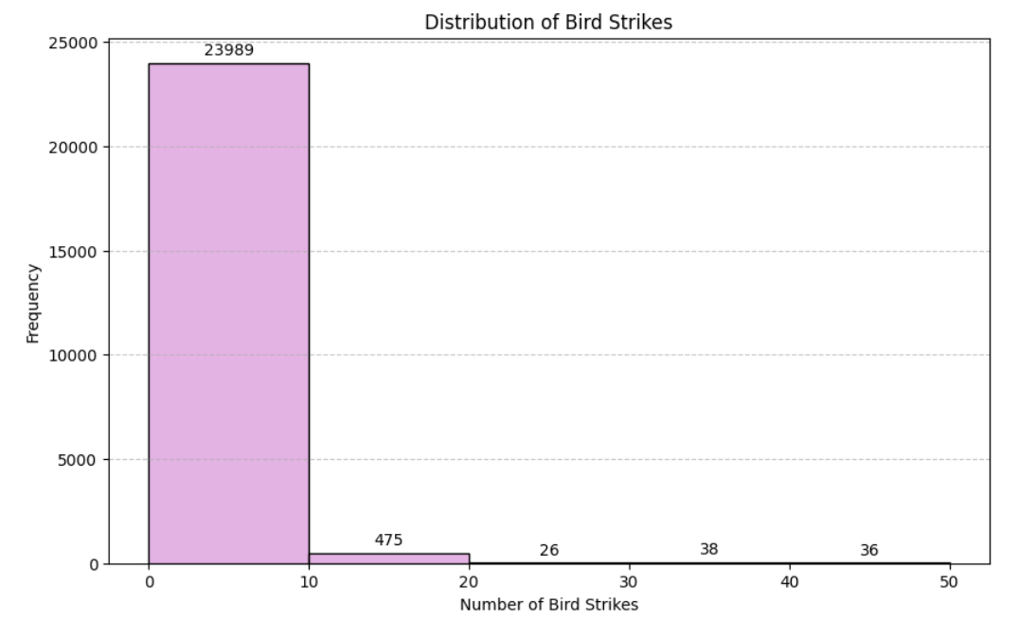
Visuals Depicting the number of Bird Strikes

Slide 7
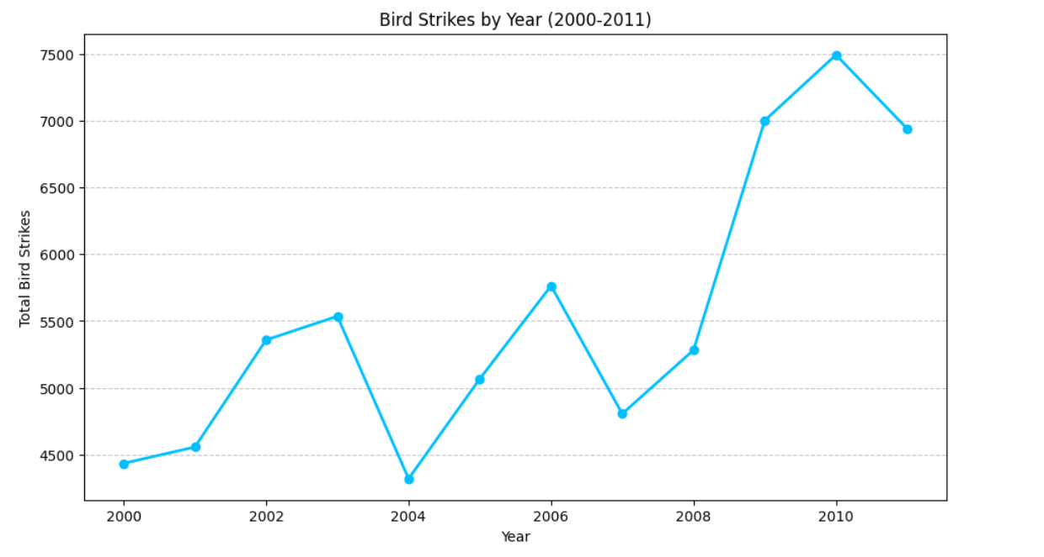
Yearly Analysis of Bird Strikes in US
The highest number of bird strikes increased in 2010.
The lowest in 2004 and 2000.

Slide 8
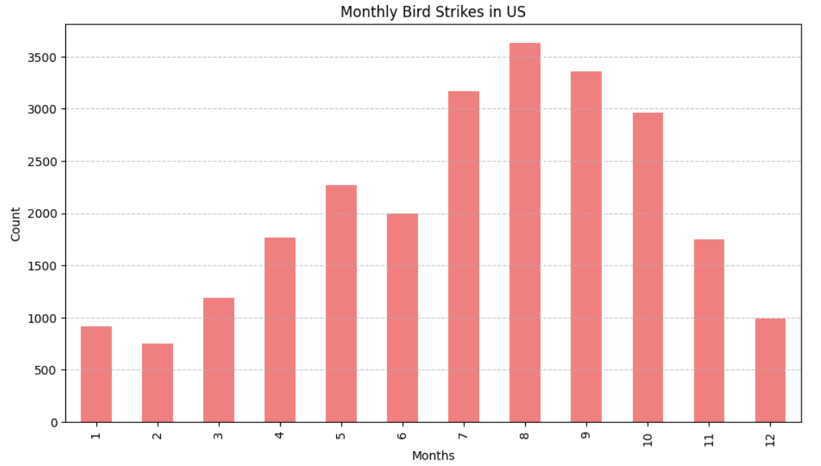
Monthly Analysis of Bird Strikes in US
Peak Months: July to October.
Lowest Months: January and February.
Trend: Noticeable increase in bird strikes starting from July, peaking in September, and then gradually decreasing.

Slide 9
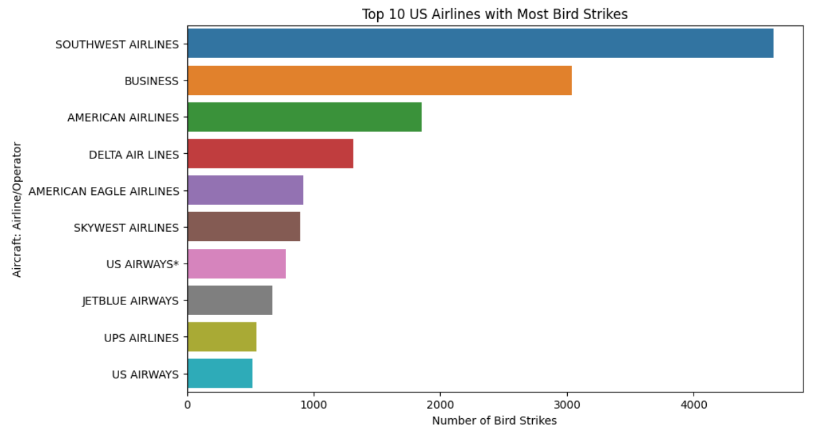
Top 10 US Airlines with Most Bird Strikes

Slide 10
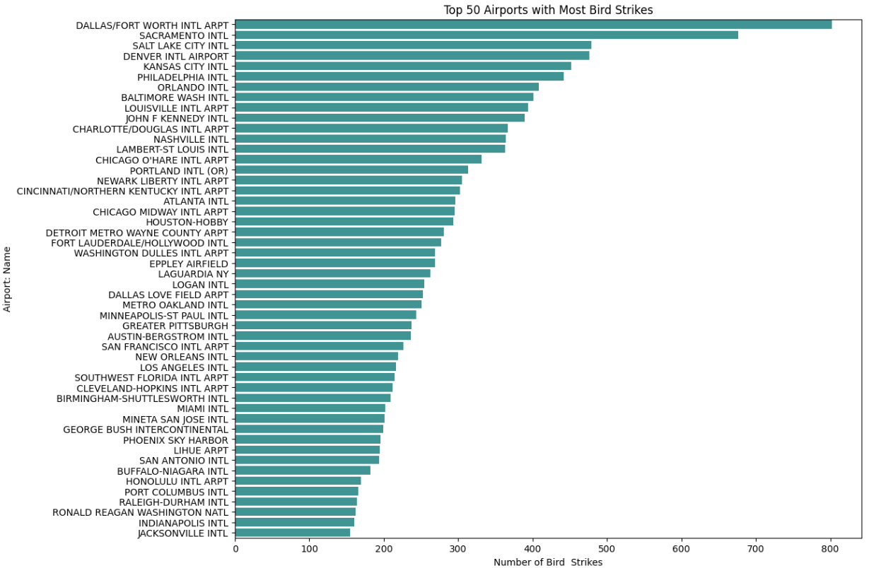
Top 50 Airports with Most Bird Strikes

Slide 11
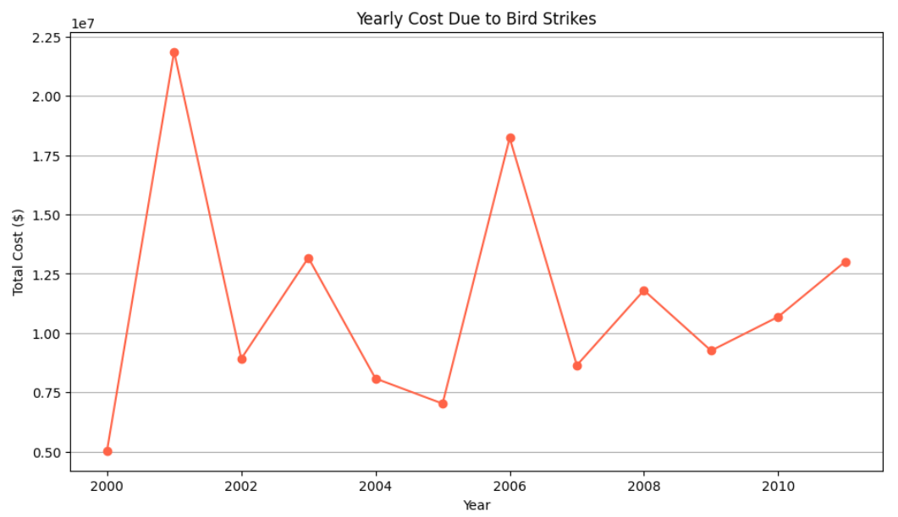
Yearly Cost Due to Bird Strikes
The cost spike notably in 2001, 2003, 2006 and 2011

Slide 12
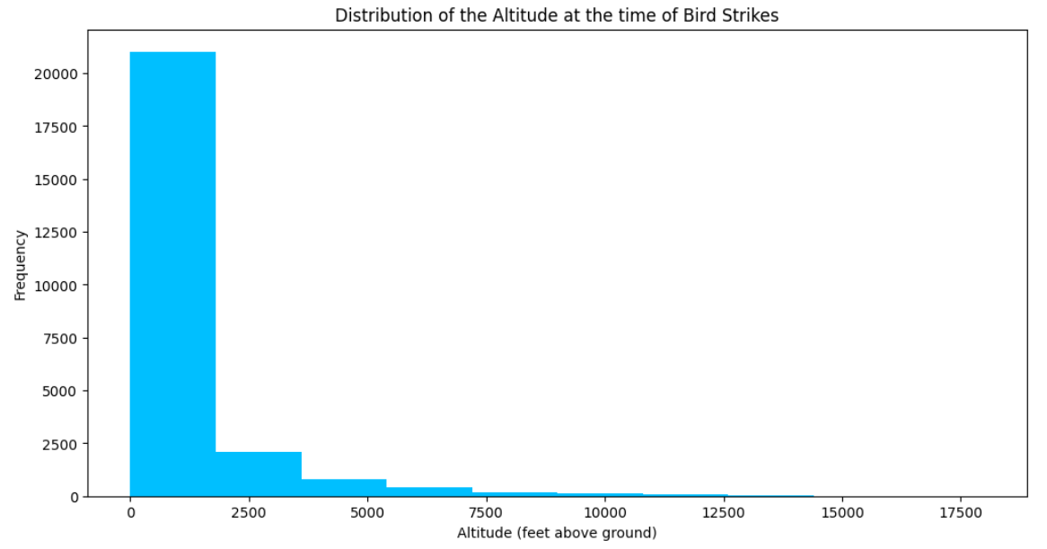
Distribution of the Altitude at the time of Bird Strikes
Mostly Altitude of the Airplane between 0-2000 when the Bird Strikes

Slide 13
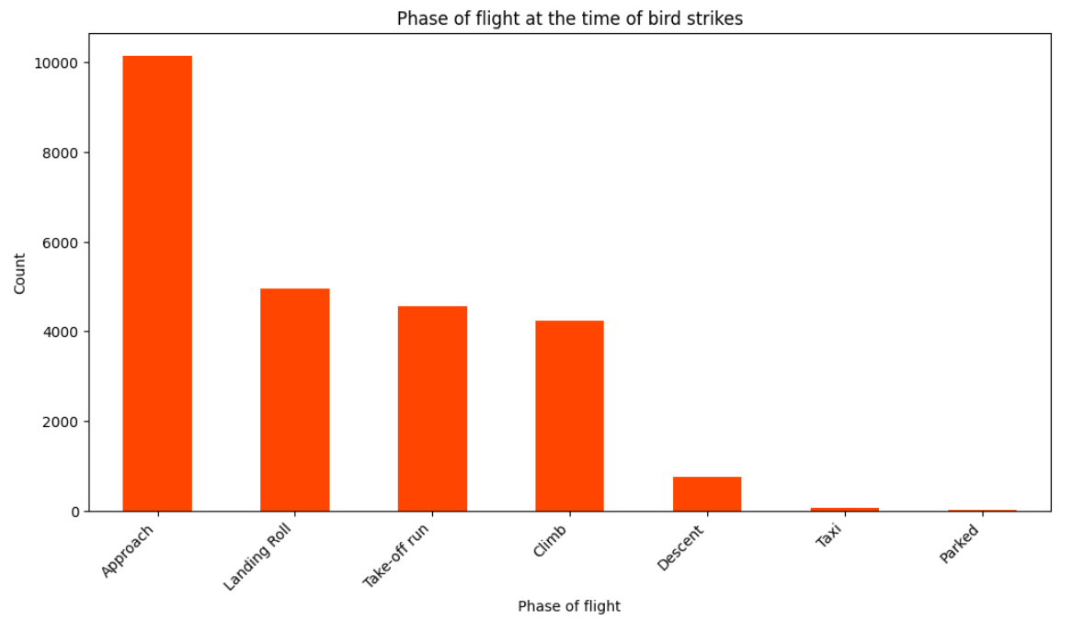
Phase of Flight at the Time of Bird Strikes
The highest number of bird strikes occur during the approach phase, with count. close to 10,000.
Landing Roll, Take-off Run, and Climb: significant number of bird strikes
Descent, Taxi, and Parked: These phases have much lower counts of bird strikes.

Slide 14
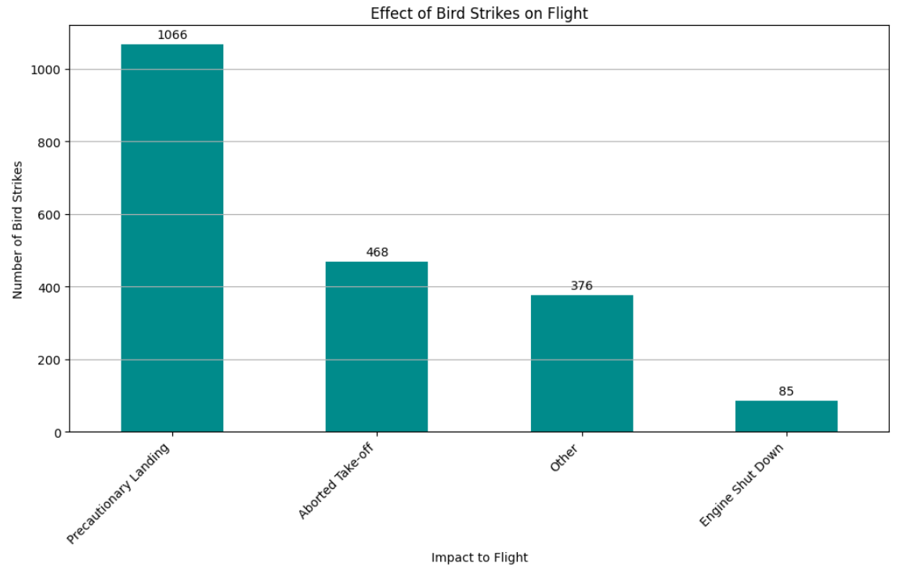
Effect of Bird Strikes on Flight
The most common result is Precautionary Landings, followed by Aborted Takeoffs.
Engine Shutdowns are the least common but still significant.

Slide 15
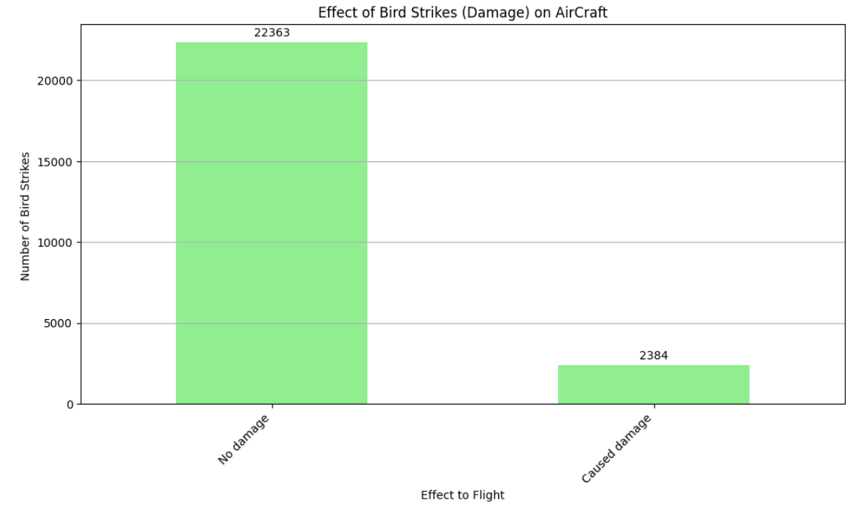
Effect of Bird Strikes (Damage) on Aircraft
Most Bird Strikes caused No damage.
Caused damage is least but still significant because of Cost to Repair.

Slide 16
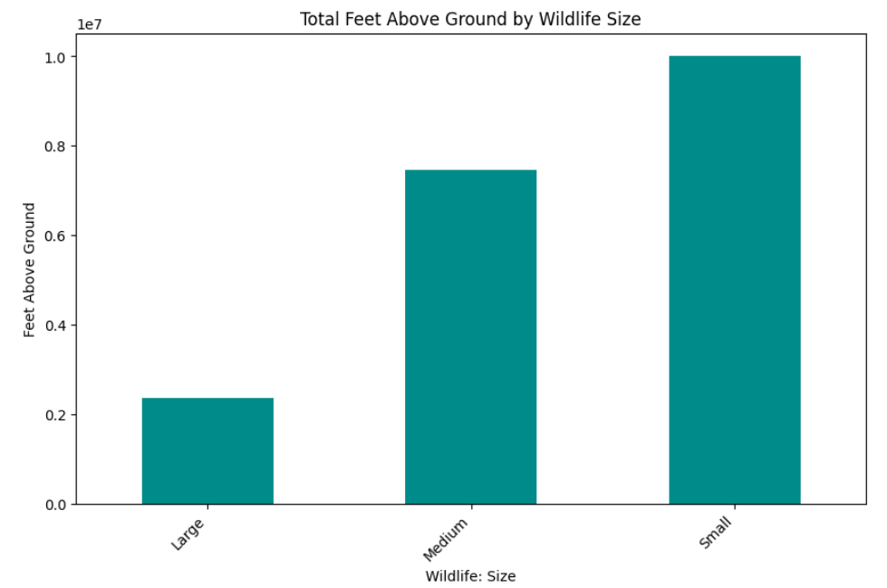
Total Feet Above Ground by Wildlife Size
Small Birds: Most frequently involved in bird strikes at higher altitudes.
Medium Birds: Also significantly involved in bird strikes, but less than small birds.
Large Birds: Least frequently involved in bird strikes at higher altitudes.

Slide 17
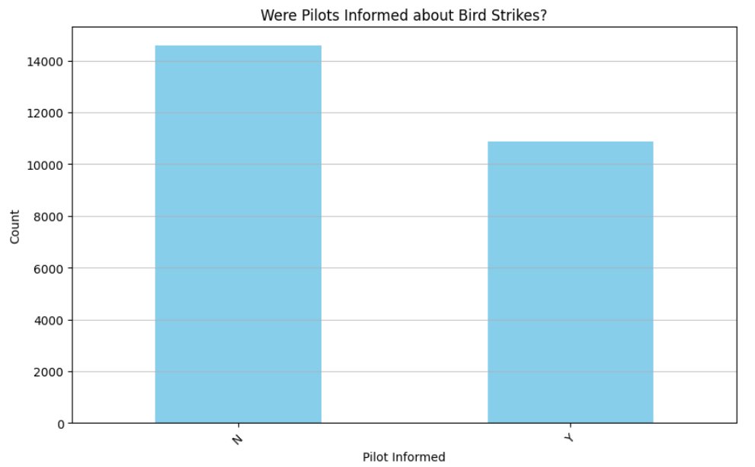
Were Pilots Informed about Bird Strikes?
Most Pilots were not informed about the Bird Strikes. This can lead to serious issues in the Aircraft.
Fewer pilots were informed about the Bird Strikes.

Slide 18
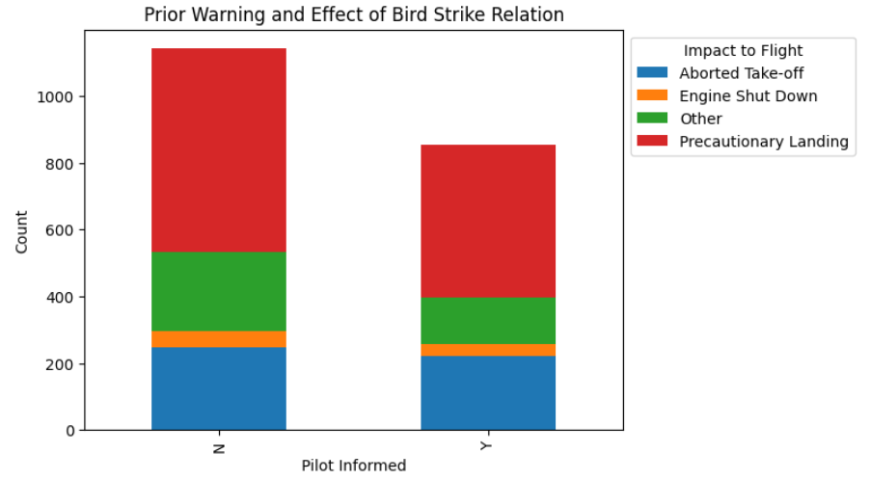
Impact of Bird Strikes with Pilot Warning
Pilot Informed: When pilots are informed about birds or wildlife, there are fewer severe impacts like engine shutdowns and aborted take-offs.
Pilot Not Informed: When pilots are not informed, there are more precautionary landings and other impacts.
Overall Trend: Prior warning to pilots reduces bird strike severity, highlighting the need for effective communication and early alerts.

Slide 19
Key Findings
Frequency and Timing of Bird Strikes:
Bird strikes are most frequent during takeoff, initial climb, approach, and landing phases due to the lower altitude.
Majority of strikes occur below 1,000 feet, highlighting the increased risk during these flight phases.

Slide 20
Key Findings
Impact on Aircraft:
Many bird strikes lead to significant aircraft damage, including engine shutdowns and precautionary landings..
Both small and large aircraft are affected, with jet engines being particularly vulnerable.

Slide 21
Key Findings
Seasonal and Temporal Trends:
Bird strikes show seasonal patterns, with higher occurrences in certain months.
Time of day also influences strike frequency, with more incidents occurring during daylight hours.

Slide 22
Key Findings
Geographical Distribution:
Certain airports and regions report higher numbers of bird strikes, indicating hotspots that may require targeted interventions.
Effect of Wildlife Size and Species:
Larger birds tend to cause more damage compared to smaller birds.
Specific species are more frequently involved in strikes, suggesting a need for species-specific management strategies.

Slide 23
Key Findings
Pilot Awareness and Warning Systems:
A significant number of incidents occur without prior warning to pilots.
Effective communication and warning systems are crucial in mitigating risks.

Slide 24
Conclusion
The analysis of bird strikes reveals that these incidents predominantly occur during the critical flight phases of takeoff, initial climb, approach, and landing, largely below 1,000 feet, making these phases particularly vulnerable.
Bird strikes often lead to significant aircraft damage, including engine shutdowns and precautionary landings, with both small and large aircraft, particularly those with jet engines, being highly susceptible.

Slide 25
Conclusion
The data shows distinct seasonal and daily patterns, with higher occurrences during certain months and daylight hours, indicating the need for heightened mitigation efforts during these times.
Geographically, specific airports and regions experience higher bird strike incidents, necessitating targeted interventions.
Larger birds and certain species cause more damage, underscoring the importance of species-specific management strategies.

Slide 26
Conclusion
Additionally, many strikes occur without prior warning to pilots, highlighting the critical need for improved communication and warning systems.
To effectively reduce the risk and impact of bird strikes, comprehensive wildlife management programs, advanced detection and monitoring systems, enhanced pilot training, aircraft design improvements, and robust communication systems are essential, ensuring greater overall flight safety.

Slide 27

Thank You

